Slide 1
Lesson 6
Maximum likelihood & Bayesian Theory

Slide 2
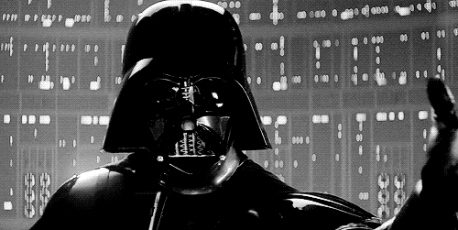
So far in clustering algorithms for sequence and evolution…
Trees are the natural way of representing relationships among species.
The number of possible trees increases factorially with the number of OTUs.

Slide 3
So far in clustering algorithms for sequence and evolution…
We need algorithms for retrieving the tree that generated the data without exploring ALL the space.
We have described movements that we can go from one tree to another in heuristic approaches for finding the best tree given a cost

Slide 4
So far in clustering algorithms for sequence and evolution…
So far we have seen methods based on generating distances between OTUs
…methods that are based on using distance matrices…

Slide 5
So far in clustering algorithms for sequence and evolution…
…and maximum parsimony, that is based in characters
Today we will look at maximum likelihood cost functions

Slide 6

So far in clustering algorithms for sequence and evolution…
Wait a moment!
LIKELIHOOD!!! That sounds like statistics!!!!!!!
NOOOOOOO!!!!!
Statistics NOOOOOOOOOO!!!!!!

Slide 7
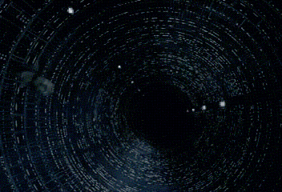
So far in clustering algorithms for sequence and evolution…

Slide 8
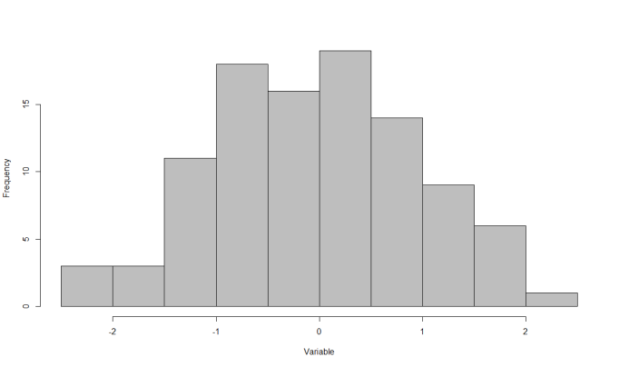
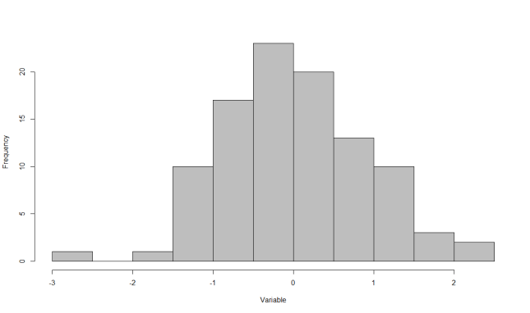
Remember: statistics
MODEL
θ
θ?

Slide 9
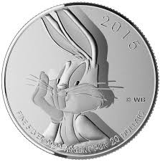
Remember: statistics
9 heads out of 50 trials
θ= fHEAD
θ?

Slide 10
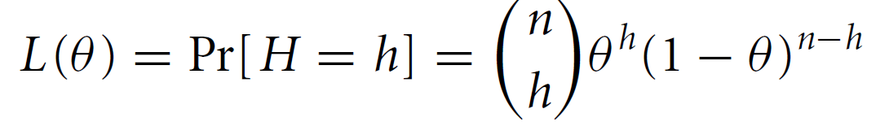
Remember: statistics
9 heads out of 50 trials
θ= fHEAD
θ?

Slide 11
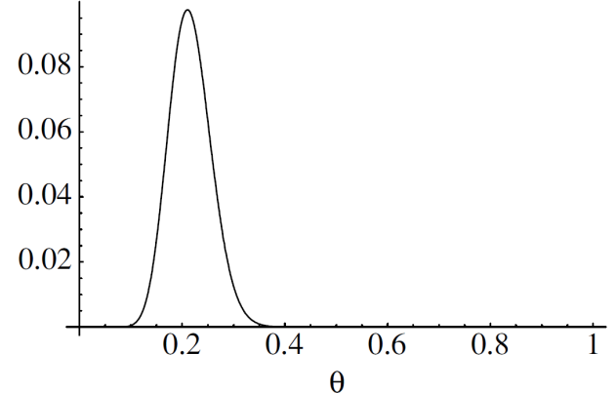
Remember: statistics
9 heads out of 50 trials
θ= fHEAD
θ?

Slide 12
Remember: statistics
Most likely value
Values covering 95% of the likely values

Slide 13
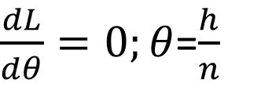
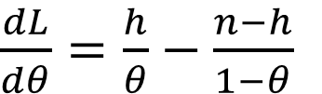
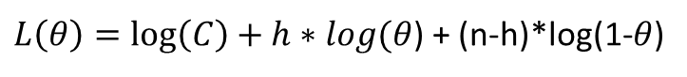
Remember: statistics
How do we recover the most likely value of the parameter θ that produced the data?
h = 9
n = 50
$\log\left(L\left(θ\right)\right)=\log\left(C\right)+h∗log(θ$) + (n-h)*log($1−θ$)
$L\left(θ\right)=\log\left(C\right)+h∗log(θ$) + (n-h)*log(1-$θ$)
$\frac{dL}{dθ}=\frac{h}{θ}−$ $\frac{n−h}{1−θ}$
$\frac{dL}{dθ}=0;θ$=$\frac{h}{n}$

Slide 14
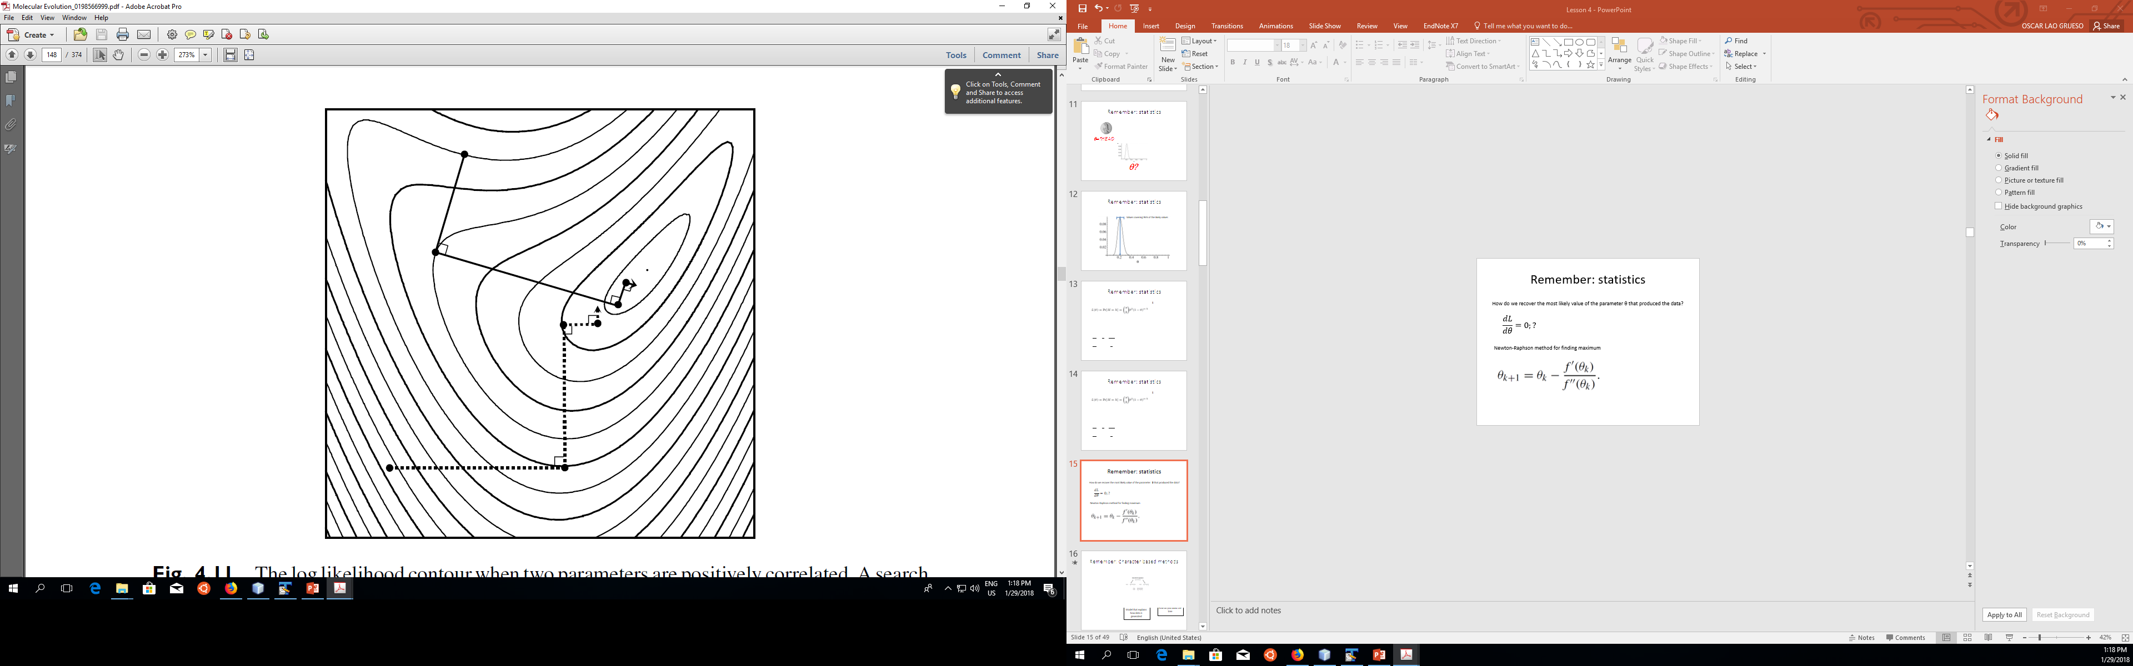
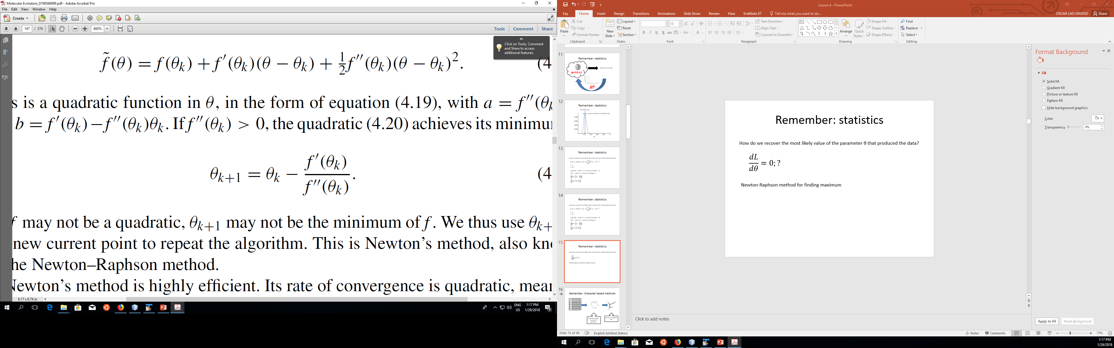
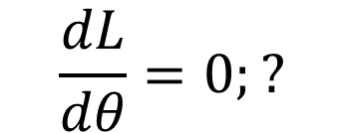
Remember: statistics
How do we recover the most likely value of the parameter θ that produced the data?
$$\frac{dL}{dθ}=0;?$$
Newton-Raphson method for finding maximum

Slide 15
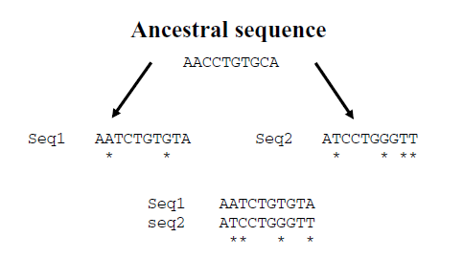
Remember: Character based methods
OTU | 1 | 2 | 3 | 4 | 5 | 6
a | A | T | A | T | A | C
b | A | T | C | T | A | C
c | G | T | C | G | A | C
d | T | T | C | G | T | C
a
b
d
c
How do you build the tree
Model that explains how data is generated

Slide 16
Remember: a model of evolution
Probability change matrix
T
C
Goes to
 | A | C | T | G
A
C
T
G
P=
Comes from
A
G

Slide 17
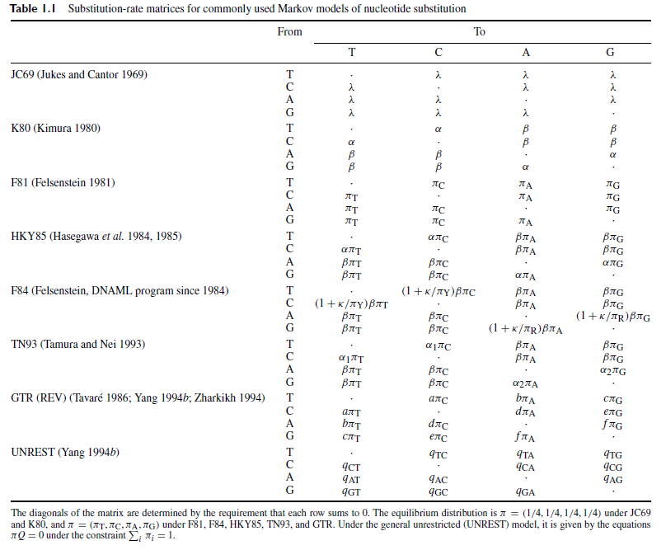
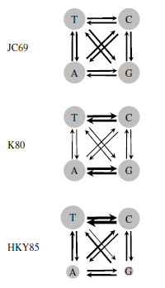
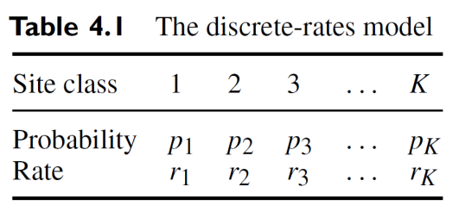
Remember: a model of evolution

Slide 18
Some basic notation
X1
OTU | 1 | 2 | 3 | 4 | 5 | 6
a | A | T | A | T | A | C
b | A | T | C | T | A | C
c | G | T | C | G | A | C
d | T | T | C | G | T | C
X =

Slide 19
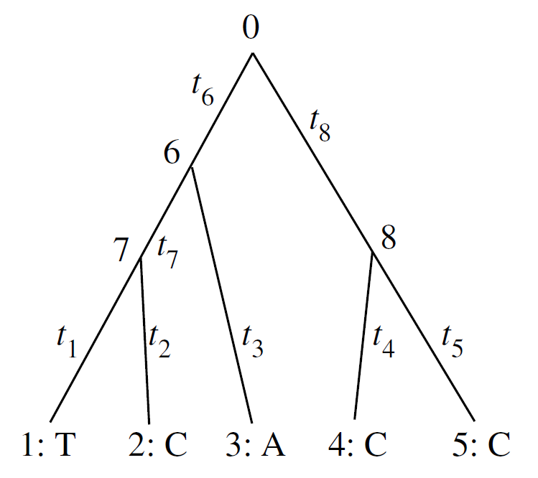
And now… Imagine that we know the topology of the tree
Branch length (expected number of changes by amount of time)
P(D|θ)
θ= {t1,t2,t3,t4,t5,t6,t7,t8}

Slide 20
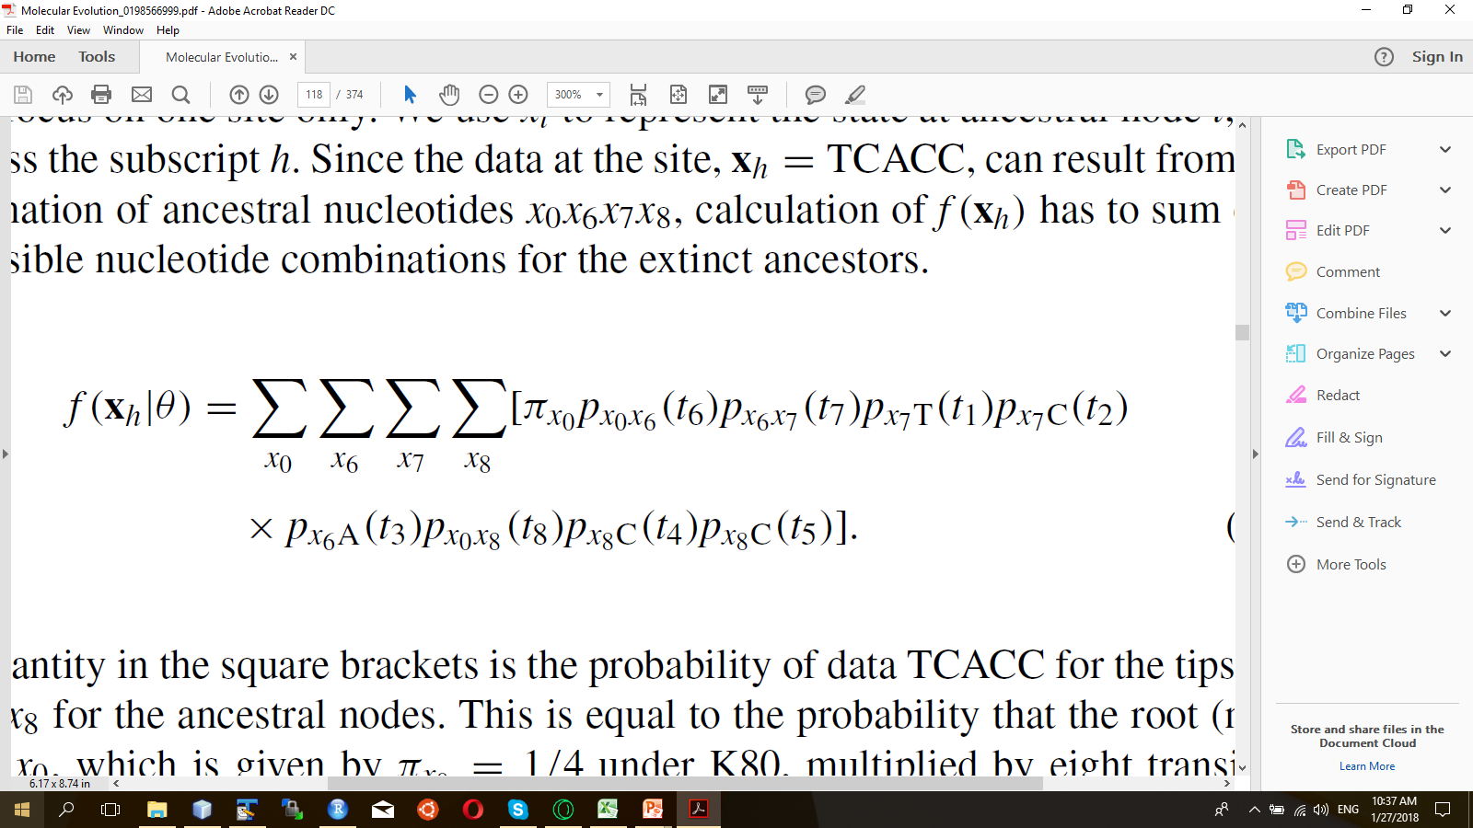
And now… Imagine that we know the topology of the tree
P(D|θ)
“What is the probability (likelihood) of observing the data given the values of the set θ of parameters”
Which is the likelihood of position h given the length of the branches and my model of nucleotide evolution?

Slide 21

Take a moment to understand it…

Slide 22
Take a moment to understand it…
Node 0
Node 6
Node 7
T
C
A
G
T
C
A
G
T
C
A
G
Leaf 1
T
Leaf 2
C
Leaf 3
A
Probability change matrix
Node 8
Goes to
 | A | C | T | G
A
C
T
G
T
C
A
G
Leaf 4
C
Leaf 5
C
P=
Comes from

Slide 23
Take a moment to understand it…
Node 0
Node 6
Node 7
T
C
A
G
T
C
A
G
T
C
A
G
Leaf 1
T
Leaf 2
C
Leaf 3
A
Probability change matrix
Node 8
Goes to
 | A | C | T | G
A
C
T
G
T
C
A
G
Leaf 4
C
Leaf 5
C
P=
Comes from

Slide 24
Take a moment to understand it…
Node 0
Node 6
Node 7
T
C
A
G
T
C
A
G
T
C
A
G
Leaf 1
T
Leaf 2
C
Leaf 3
A
Probability change matrix
Node 8
Goes to
 | A | C | T | G
A
C
T
G
T
C
A
G
Leaf 4
C
Leaf 5
C
P=
Comes from

Slide 25
Take a moment to understand it…
Node 0
Node 6
Node 7
T
C
A
G
T
C
A
G
T
C
A
G
Leaf 1
T
Leaf 2
C
Leaf 3
A
Probability change matrix
Node 8
Goes to
 | A | C | T | G
A
C
T
G
T
C
A
G
Leaf 4
C
Leaf 5
C
P=
Comes from

Slide 26
What would be the likelihood of this tree?
0
t5
t6
1
3
t3
t7
2
4
t8
t1
t2
t4
t9
t10
1:A
2:T
3:T
4:A
5:C
6:A

Slide 27

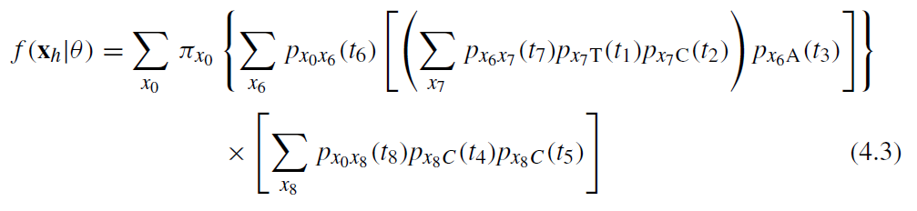
Felselstein’s pruning algorithm

Slide 28
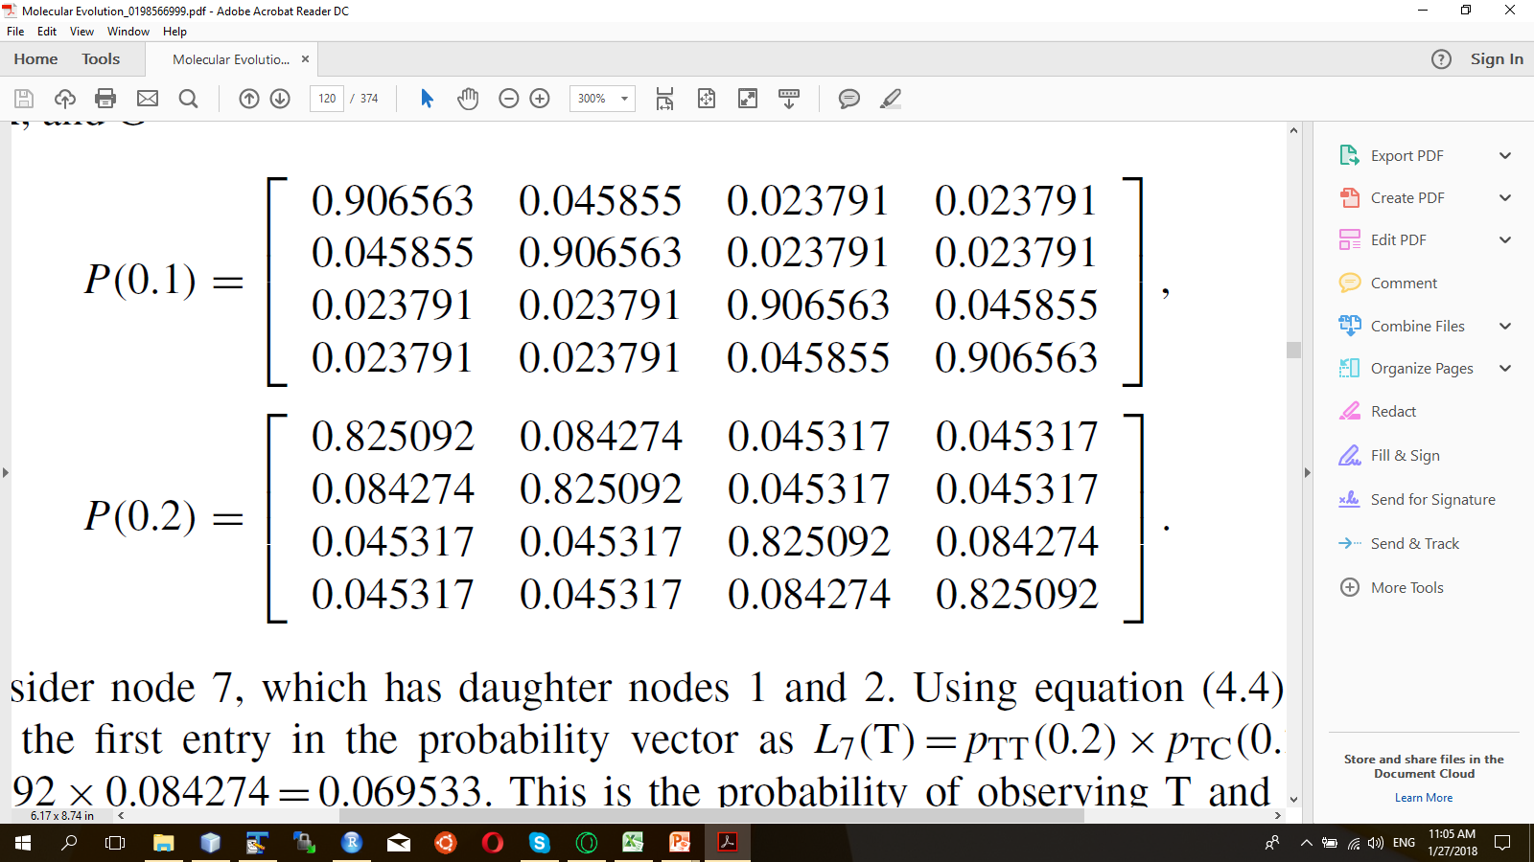
And now… Imagine that we know the topology of the tree and the parameters!
T C A G
0.1
T
C
A
G
0.1
0.1
T
C
A
G
0.2
0.2
0.2
0.2
0.2

Slide 29
And now… Imagine that we know the topology of the tree and the parameters!
Now I am
T C A G
T
C
A
G
At the beginning of the node I was

Slide 30
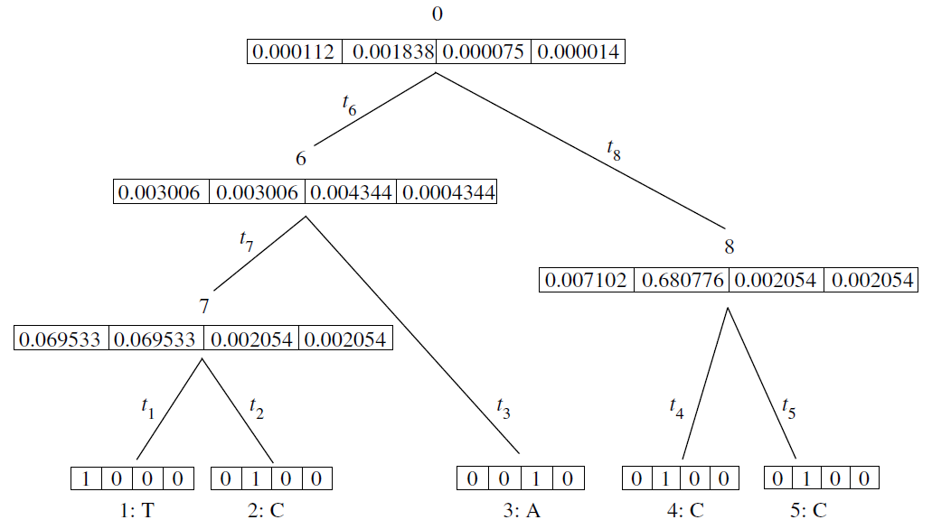
And now… Imagine that we know the topology of the tree and the parameters!
The pruning algorithm for estimating the likelihood
T C A G
T
C
A
G
T C A G

Slide 31
And now… Imagine that we know the topology of the tree and the parameters!
T C A G
T
C
A
G
T C A G

Slide 32
And now… Imagine that we know the topology of the tree and the parameters!
T C A G
T
C
A
G
T C A G
0.084274
0.084274

Slide 33
And now… Imagine that we know the topology of the tree and the parameters!
T C A G
T
C
A
G
T C A G
0.007102
0.084274
0.084274

Slide 34
And now… Imagine that we know the topology of the tree and the parameters!
T C A G
T
C
A
G
T C A G
0.007102 | 0.680776 | 0.002054 | 0.002054

Slide 35
And now… Imagine that we know the topology of the tree and the parameters!
T C A G
T
C
A
G
T C A G
0.007102 | 0.680776 | 0.002054 | 0.002054
T C A G

Slide 36
And now… Imagine that we know the topology of the tree and the parameters!
P(t6=T|1:T,2:C,3:A)?
T C A G
T C A G
0.007102 | 0.680776 | 0.002054 | 0.002054
T C A G

Slide 37

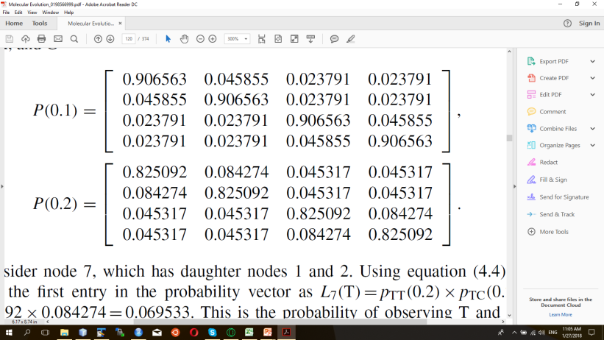
And now… Imagine that we know the topology of the tree and the parameters!
T C A G
T
C
A
G
T C A G
T
C
A
G
T C A G
T C A G
0.007102 | 0.680776 | 0.002054 | 0.002054
T C A G

Slide 38

And now… Imagine that we know the topology of the tree and the parameters!
T C A G
T
C
A
G
T C A G
T
C
A
G
T C A G
T C A G
0.007102 | 0.680776 | 0.002054 | 0.002054
T C A G

Slide 39
And now… Imagine that we know the topology of the tree and the parameters!
T C A G
T
C
A
G
T C A G
T
C
A
G
T C A G
T C A G
0.007102 | 0.680776 | 0.002054 | 0.002054
T C A G

Slide 40
And now… Imagine that we know the topology of the tree and the parameters!
T C A G
T
C
A
G
T C A G
T
C
A
G
T C A G
T C A G
0.007102 | 0.680776 | 0.002054 | 0.002054
T C A G
P(t6=T|1:T,2:C,3:A)= ((0.906563*0.069533)+(0.045855*0.069533)+(0.023791*0.002054)+(0.023791*0.002054))*0.045317

Slide 41
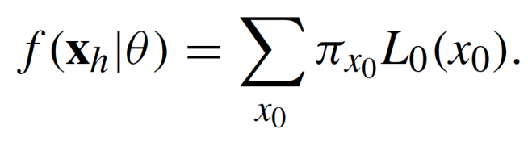
And now… Imagine that we know the topology of the tree and the parameters!

Slide 42
And now… Imagine that we know the topology of the tree and the parameters!
$$f\left(X_{h} | θ\right)=\frac{1}{4}\left(0.000112+0.001838+0.000075+0.000014\right)$$

Slide 43
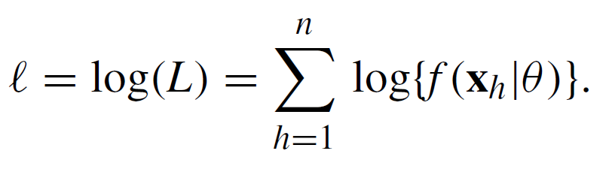
And now… Imagine that we know the topology of the tree
P(D|θ)
“What is the probability (likelihood) of observing the data given the values of the set of parameters”
Which is the loglikelihood of all the positions given the length of the branches and my model of nucleotide evolution?
This is the parameter we want to maximize!

Slide 44
What we want to do?
Parameters
Branch length
Rates of substitution
Topology
Relationship between OTUs

Slide 45
What we want to do?
Maximizing Parameters of a given tree
Propose a new tree

Slide 46
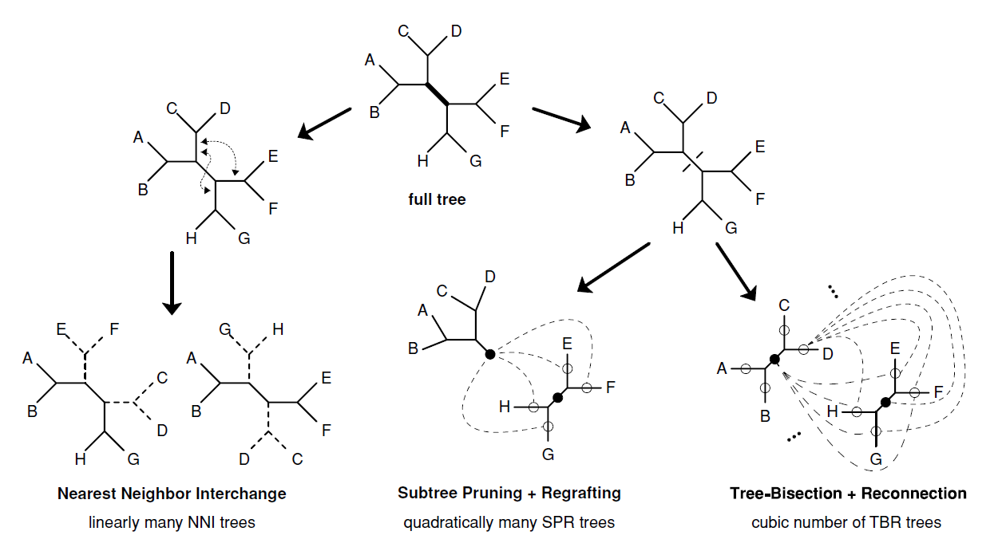
What we want to do?

Slide 47
What we want to do?

Slide 48
Which are the differences between maximum parsimony and maximum likelihood?

Slide 49
Bayesian methods
The area does not add to 1!
P(D|θ)
What if we knew from previous experiences that some values are more likely than others?

Slide 50
Bayesian methods
What if we knew from previous experiences that some values are more likely than others?
P(θ)P(D|θ)

Slide 51
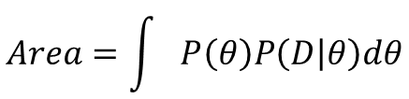
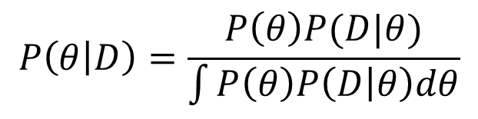
Bayesian methods
The area does not add to 1!
$$Area=\int{P\left(θ\right)P\left(D | θ\right)dθ}$$
P(θ)P(D|θ)
$$P\left(θ | D\right)=\frac{P\left(θ\right)P(D|θ)}{\int{P\left(θ\right)P\left(D | θ\right)dθ}}$$

Slide 52
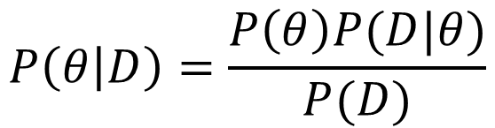
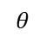

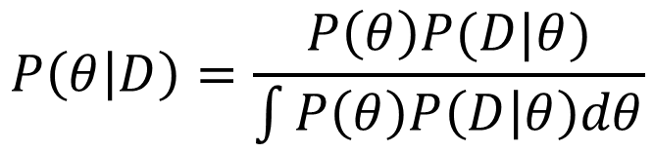
A formal way of expressing it…
Bayesian methods
$$P\left(D;θ\right)=P\left(θ\right)P\left(D | θ\right)=P\left(D\right)P\left(θ | D\right)$$
$$P\left(D\right)=\int{P\left(θ\right)P\left(D | θ\right)dθ}$$
Prior knowledge
$$P\left(θ | D\right)=\frac{P\left(θ\right)P(D|θ)}{P(D)}$$
“our current knowledge is a mixture of what we previously knew updated with new data”
Posterior distribution of
$$θ$$
Normalizing constant
$$P\left(θ | D\right)=\frac{P\left(θ\right)P(D|θ)}{\int{P\left(θ\right)P\left(D | θ\right)dθ}}$$
“integrating over the marginals”

Slide 53
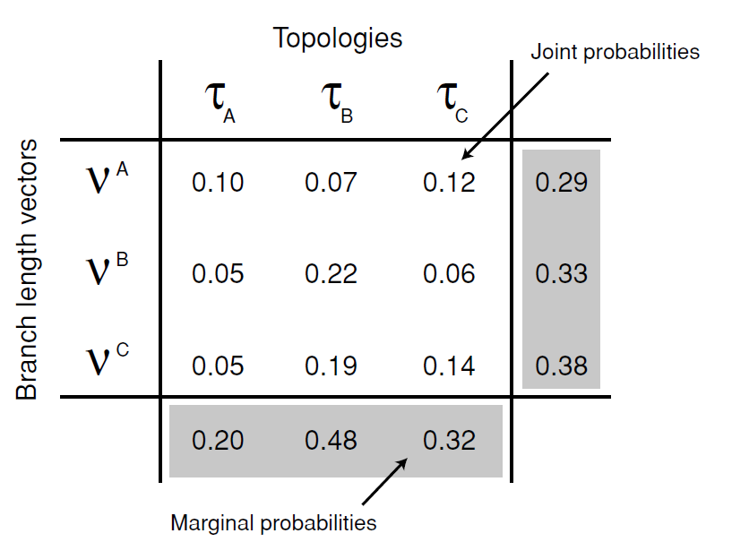
Some extra definitions
Bayesian methods

Slide 54
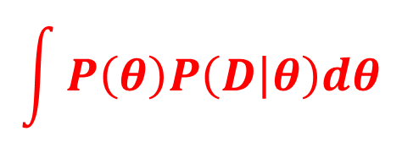
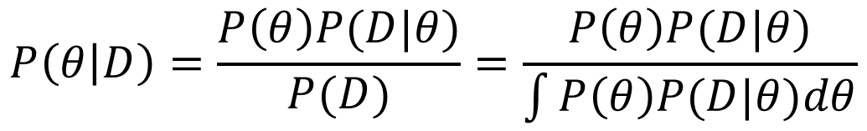
Remember: Bayesian statistics
Bayesian methods
$$P\left(θ | D\right)=\frac{P\left(θ\right)P(D|θ)}{P(D)}=\frac{P\left(θ\right)P(D|θ)}{\int{P\left(θ\right)P(D|θ)dθ}}$$
$$\int{P\left(θ\right)P\left(D | θ\right)dθ}$$

Slide 55
Bayesian methods
$$P\left(θ | D\right)=\frac{P\left(θ\right)P(D|θ)}{P(D)}=\frac{P\left(θ\right)P(D|θ)}{\int{P\left(θ\right)P(D|θ)dθ}}$$
$$\int{P\left(θ\right)P\left(D | θ\right)dθ}$$
What if it does not exist?

Slide 56
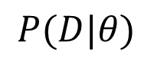
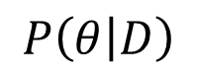
A continuous variable: The head problem revisited
Bayesian methods
9 heads out of 50 trials
θ= fHEAD
$$P(D|θ)$$
$$P\left(θ | D\right)$$

Slide 57
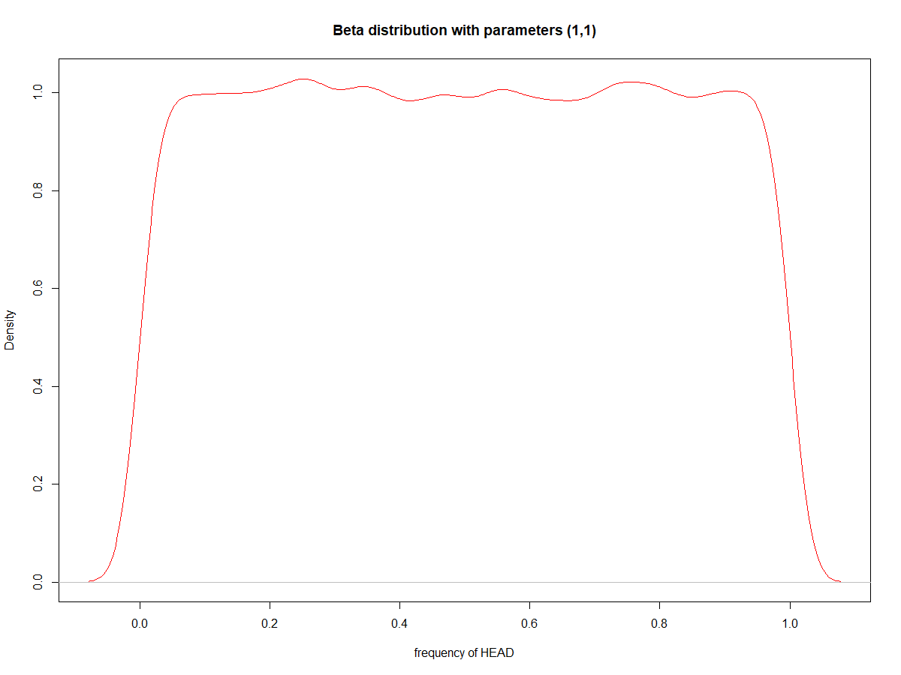
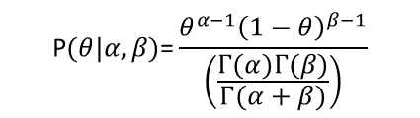
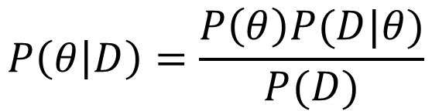
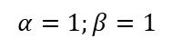
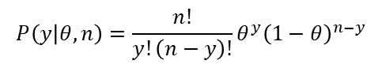
How to get the Posterior?
Bayesian methods
Assume uniform prior knowledge (“the frequency can be any value between 0 and 1 with equal probability”)
$$P\left(θ | D\right)=\frac{P\left(θ\right)P(D|θ)}{P(D)}$$
Binomial Distribution
$$P\left(y | θ,n\right)=\frac{n!}{y!\left(n−y\right)!}θ^{y}{\left(1−θ\right)}^{n−y}$$
Beta distribution
$$\text{P}(θ|α,β)\text{=}\frac{θ^{α−1}{\left(1−θ\right)}^{β−1}}{\left(\frac{Γ(α)Γ(β)}{Γ(α+β)}\right)}$$
$$α=1;β=1$$

Slide 58
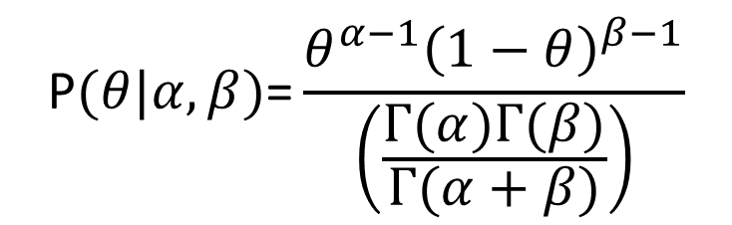
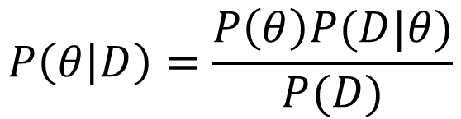
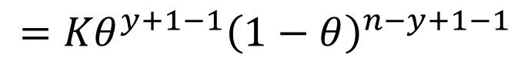
Remember: Bayesian statistics
Bayesian methods
$$P\left(θ | D\right)=\frac{P\left(θ\right)P(D|θ)}{P(D)}$$
$$={Kθ}^{y+1−1}{\left(1−θ\right)}^{n−y+1−1}$$
$$\text{P}(θ|α,β)\text{=}\frac{θ^{α−1}{\left(1−θ\right)}^{β−1}}{\left(\frac{Γ(α)Γ(β)}{Γ(α+β)}\right)}$$
Beta distribution
“Beta distribution is a conjugate of the Binomial distribution”

Slide 59
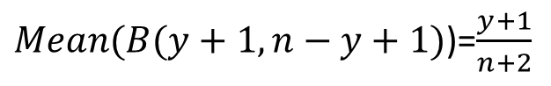
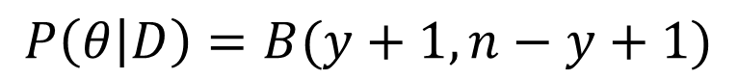
Remember: Bayesian statistics
Bayesian methods
$$P\left(θ | D\right)=\frac{P\left(θ\right)P(D|θ)}{P(D)}$$
$$={Kθ}^{y+1−1}{\left(1−θ\right)}^{n−y+1−1}$$
$$\text{P}(θ|α,β)\text{=}\frac{θ^{α−1}{\left(1−θ\right)}^{β−1}}{\left(\frac{Γ(α)Γ(β)}{Γ(α+β)}\right)}$$
Beta distribution
$$P\left(θ | D\right)=B(y+1,n−y+1)$$
$Mean(B(y+1,n−y+1)$)=$\frac{y+1}{n+2}$

Slide 60
Remember: Bayesian statistics
Bayesian methods
$$P\left(θ | D\right)=\frac{P\left(θ\right)P(D|θ)}{P(D)}=\frac{P\left(θ\right)P(D|θ)}{\int{P\left(θ\right)P(D|θ)dθ}}$$
$$\int{P\left(θ\right)P\left(D | θ\right)dθ}$$
What if there is no conjugate?
What if it does not exist?

Slide 61
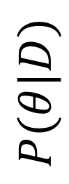
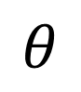
Bayesian methods
$$P(θ|D)$$
$$θ$$

Slide 62
Bayesian methods
At least, is there any way we can generate samples from this (unknown) posterior distribution so we can broadly regenerate the (unknown) posterior distribution?
$$P(θ|D)$$
?
$$θ$$

Slide 63
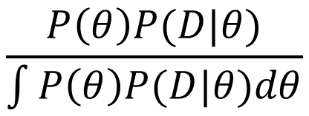
Bayesian methods
$$\frac{P\left(θ\right)P(D|θ)}{\int{P\left(θ\right)P(D|θ)dθ}}$$
$$P(θ|D)$$
?
$$θ$$

Slide 64
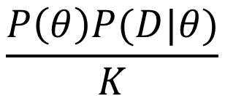
Bayesian methods
$$\frac{P\left(θ\right)P(D|θ)}{K}$$
$$P(θ|D)$$
?
$$θ$$

Slide 65

Bayesian methods
How many times is more likely j than i in this (unknown) distribution?
$$r\left(i,j\right)=\frac{\frac{P\left(θ=i\right)P(D|θ=i)}{K}}{\frac{P\left(θ=j\right)P(D|θ=j)}{K}}=\frac{P\left(θ=i\right)P(D|θ=i)}{P\left(θ=j\right)P(D|θ=j)}=\frac{π(j)}{π(i)}$$

Slide 66
Bayesian methods
Markov Chain Monte Carlo Methods: Metropolis algorithm
1) Initialize i (pick a value of θ at random)
$$P(θ|D)$$
?
i
$$θ$$

Slide 67



Bayesian methods
Markov Chain Monte Carlo Methods: Metropolis algorithm
Initialize i (pick a value of θ at random)
Propose a movement q(.|i)
P(q(j|i))=P(q(i|j))
$$A=N\left(i,σ\right)$$
$$P(θ|D)$$
?
$$B=N\left(j,σ\right)$$
$$P\left(j | A\right)=p(i|B)$$
i
j
$$θ$$

Slide 68

Bayesian methods
Markov Chain Monte Carlo Methods: Metropolis algorithm
Initialize i (pick a value of θ at random)
Propose a movement q(.|i)
Compute
$$r\left(i,j\right)=\frac{π\left(j\right)}{π\left(i\right)}$$
$$P(θ|D)$$
?
i
j
$$θ$$

Slide 69

Bayesian methods
Markov Chain Monte Carlo Methods: Metropolis algorithm
Initialize i (pick a value of θ at random)
Propose a movement q(.|i)
Compute
Move to j in probability
$$r\left(i,j\right)=\frac{π\left(j\right)}{π\left(i\right)}$$
$$P(θ|D)$$
?
$α\left(i,j\right)=min⁡(1,r(i,j)$)
“acceptance ratio”
i
j
$$θ$$

Slide 70

Bayesian methods
Markov Chain Monte Carlo Methods: Metropolis-Hastings
Initialize i (pick a value of θ at random)
Propose a movement q(.|i)
Compute
Move to j in probability
$$r\left(i,j\right)=\frac{π\left(j\right)q(i|j)}{π\left(i\right)q(j|i)}$$
$$P(θ|D)$$
?
$α\left(i,j\right)=min⁡(1,r(i,j)$)
j
$$θ$$

Slide 71

Bayesian methods
Markov Chain Monte Carlo Methods: Metropolis-Hastings
$$P(θ|D)$$
?
X
Y
$$θ$$

Slide 72
The head problem revisited
Bayesian methods
9 heads out of 50 trials
θ= fHEAD
$$P(D|θ)$$
$$P\left(θ | D\right)$$

Slide 73


Example of the Metropolis algorithm at work!
Bayesian methods
$$P\left(θ | D\right)=\frac{P\left(θ\right)P(D|θ)}{P(D)}=\frac{U\left(0,1\right)Binom\left(h|θ,n\right)}{?}$$
$$Binom\left(h | θ,n\right)=\frac{n!}{h!\left(n−h\right)!}θ^{h}{\left(1−θ\right)}^{n−h}$$

Slide 74

Example of the Metropolis algorithm at work!
Bayesian methods
$$P\left(θ | D\right)=\frac{P\left(θ\right)P(D|θ)}{P(D)}=\frac{U\left(0,1\right)Binom\left(h|θ,n\right)}{?}$$
$$Binom\left(h | θ,n\right)=\frac{n!}{h!\left(n−h\right)!}θ^{h}{\left(1−θ\right)}^{n−h}$$
h = 9;
n = 50
$$q\left(.|X_{t}\right)=N(X_{t},1)$$

Slide 75

Example of the Metropolis algorithm at work!
Bayesian methods
$$P\left(θ | D\right)=\frac{P\left(θ\right)P(D|θ)}{P(D)}=\frac{U\left(0,1\right)Binom\left(h|θ,n\right)}{?}$$
$$Binom\left(h | θ,n\right)=\frac{n!}{h!\left(n−h\right)!}θ^{h}{\left(1−θ\right)}^{n−h}$$
h = 9;
n = 50
$$θ=[0,1]$$
$$q\left(.|X_{t}\right)=N(X_{t},1)$$

Slide 76
A potential problem with this variable definition…
Bayesian methods
I am proposing movements to values out of the range!!!!!
Probability of moving from Xt to Xt+1
0
1
θ

Slide 77

Example of the Metropolis algorithm at work!
Bayesian methods
$$P\left(θ | D\right)=\frac{P\left(θ\right)P(D|θ)}{P(D)}=\frac{U\left(0,1\right)Binom\left(h|θ,n\right)}{?}$$
$$Binom\left(h | θ,n\right)=\frac{n!}{h!\left(n−h\right)!}θ^{h}{\left(1−θ\right)}^{n−h}$$
h = 9;
n = 50
$$ζ=log\left(\frac{θ}{1−θ}\right);$$
$θ=[0,1]$;
$ζ= \left(−∞,∞\right)$
$$q\left(.|X_{t}\right)=N(X_{t},1)$$

Slide 78


Now there is no problem anymore!
Bayesian methods
$$θ=\frac{e^{ζ }}{1+e^{ζ }}$$
$$ζ$$

Slide 79


Example of the Metropolis algorithm at work!
Bayesian methods
$$P\left(θ | D\right)=\frac{P\left(θ\right)P(D|θ)}{P(D)}=\frac{U\left(0,1\right)Binom\left(h|θ,n\right)}{?}$$
$$Binom\left(h | θ,n\right)=\frac{n!}{h!\left(n−h\right)!}θ^{h}{\left(1−θ\right)}^{n−h}$$
h = 9;
n = 50
$$ζ_{0}=0; θ_{0}=0.5;P\left(9 | 0.5,50\right)=\text{2.2}\text{e}\text{−06}$$
$$q\left(.|X_{t}\right)=N(X_{t},1)$$
Y$=−0.46; Y_{θ}=0.38$; $P\left(9 | 0.38,50\right)=\text{0.0012}$

Slide 80

Example of the Metropolis algorithm at work!
Bayesian methods
$$P\left(θ | D\right)=\frac{P\left(θ\right)P(D|θ)}{P(D)}=\frac{U\left(0,1\right)Binom\left(h|θ,n\right)}{?}$$
$$Binom\left(h | θ,n\right)=\frac{n!}{h!\left(n−h\right)!}θ^{h}{\left(1−θ\right)}^{n−h}$$
h = 9;
n = 50
$$ζ_{0}=0; θ_{0}=0.5;P\left(9 | 0.5,50\right)=\text{2.2}\text{e}\text{−06}$$
$$q\left(.|X_{t}\right)=N(X_{t},1)$$
Y$=−0.46; Y_{θ}=0.38$; $P\left(9 | 0.38,50\right)=\text{0.0012}$
$$U=\text{0.9661937}$$

Slide 81


Example of the Metropolis algorithm at work!
Bayesian methods
$$P\left(θ | D\right)=\frac{P\left(θ\right)P(D|θ)}{P(D)}=\frac{U\left(0,1\right)Binom\left(h|θ,n\right)}{?}$$
$$Binom\left(h | θ,n\right)=\frac{n!}{h!\left(n−h\right)!}θ^{h}{\left(1−θ\right)}^{n−h}$$
h = 9;
n = 50
$$ζ_{0}=0; θ_{0}=0.5;P\left(9 | 0.5,50\right)=\text{2.2}\text{e}\text{−06}$$
$$q\left(.|X_{t}\right)=N(X_{t},1)$$
Y$=−0.46; Y_{θ}=0.38$; $P\left(9 | 0.38,50\right)=\text{0.0012}$
$$U=\text{0.9661937}$$
$$α(θ_{0},Y_{θ})=\frac{0.0012}{2.2e−06}=572.28$$
$ζ_{1}=−0.46;θ_{1}=0.38$; $P\left(9 | 0.38,50\right)=\text{0.0012}$

Slide 82

Posterior distribution found by Metropolis

Slide 83

Bayesian methods
MCMC: Metropolis-Hastings single component update
What happens if we have more than one parameter to estimate?
Update X.1 at time 1
Update X.2 at time 2

Slide 84

MCMC in practice
Bayesian methods
When to stop?
Usually we start out of the most likely values of the posterior

Slide 85

MCMC in practice: good mixing
Bayesian methods

Slide 86

MCMC in practice: bad mixing
Bayesian methods

Slide 87

MCMC in practice: bad mixing
Bayesian methods

Slide 88
Bayesian methods
MCMC: Why poor mixing?

Slide 89
Bayesian methods
MCMC: Why poor mixing?
That would be much better!

Slide 90

MCMC in practice: bad mixing
Bayesian methods

Slide 91
Bayesian methods
MCMC: Why poor mixing?

Slide 92
Bayesian methods
MCMC: Why poor mixing?

Slide 93
Bayesian methods
MCMC: Why poor mixing?
That would be much better!

Slide 94
Bayesian methods
MCMC: Why poor mixing?
BUT THAT MEANS THAT WE KNOW THE SHAPE OF THE POSTERIOR DISTRIBUTION!
WHICH IS NOT THE CASE!!!!
That would be much better!

Slide 95

MCMC in practice: Lack of convergence
Bayesian methods

Slide 96

Yet another issue: multimodality
Bayesian methods

Slide 97

MCMC: Be careful
Bayesian methods

Slide 98
MCMC in practice
Bayesian methods
The final GOAL of MCMC is to retrieve samples from the posterior distribution without having a close form of this distribution
However, we start at a random point of the parameter space, which probably has a low probability given the data.
We want independent samples from the posterior distribution. However, we are doing walks that depends from previous sampled values...

Slide 99
MCMC: Some hints
Bayesian methods
Define burn-in
Run more than one MCMC chain and check convergence of the loglikelihood.
Compute metrics of autocorrelation between t and t+k
Is good the mixing?
Define lag between accepted runs

Slide 100

Example of the Metropolis algorithm at work!
Bayesian methods

Slide 101

Example of the Metropolis algorithm at work
Bayesian methods

Slide 102

Bayesian phylogenetics
Bayesian methods
T
C
Branch length
A
G

Slide 103

Bayesian phylogenetics
Bayesian methods

Slide 104

Bayesian phylogenetics
Bayesian methods

Slide 105

Bayesian phylogenetics
Bayesian methods

Slide 106
Bayesian phylogenetics: how to summarize results? From a tree point of view
Tree showing the largest posterior probability
P(Ti|D)= (0.35, 0.25, 0.20, 0.15, 0.03)
CDF= (0.35, 0.6, 0.80, 0.95, 0.98)
“Trees corresponding to 95% Credible Interval”

Slide 107
Bayesian phylogenetics: how to summarize results? From a branch point of view
Branch length
Mean, median, mode
95% Credible interval
How often this branch is retrieved?

